Slide 1
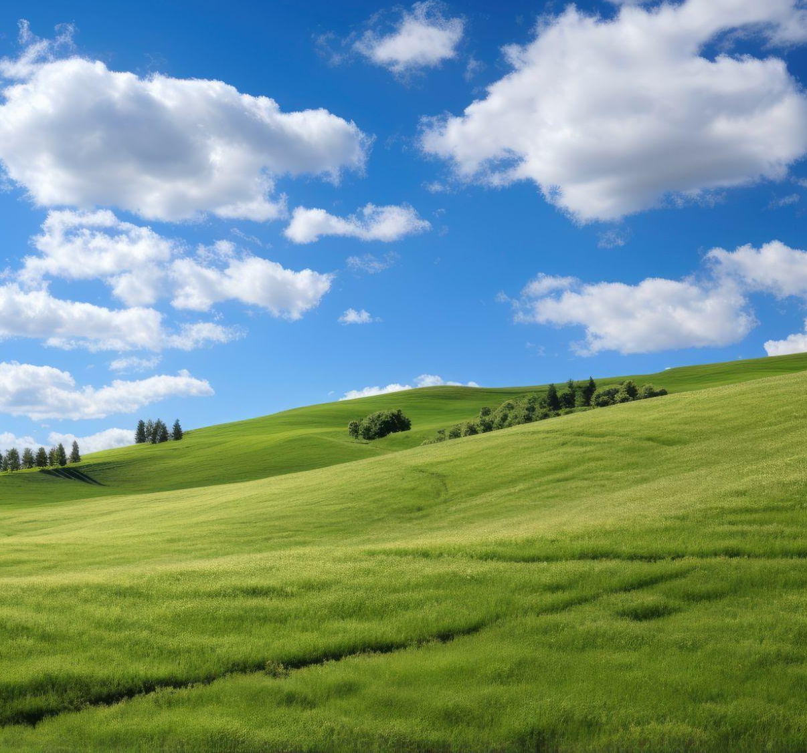
Digital
Nostalgia
Style
Write your Name
Here is where your
presentation begins

Slide 2

Contents of this template
Fonts
Colors
Thanks slide
Icons and infographics
To view this template correctly in PowerPoint, download and install the fonts we used
You can see on the link all the colors used in this presentation
You must keep it so that proper credits for our design are given
These can be used in the template, and their size and color can be edited
For more info: SLIDESGO | SLIDESGO AI TOOLS | BLOG | FAQs
You can edit the master slides easily. For more info, click here
You can visit our sister projects: FREEPIK AI TOOLS | FREEPIK LIBRARY RESOURCES
You can delete this slide when you’re done editing the presentation

Slide 3
Table of contents
01
05
02
06
03
07
04
08
Name of the section
Name of the section
Name of the section
Name of the section
Name of the section
Name of the section
Name of the section
Name of the section

Slide 4
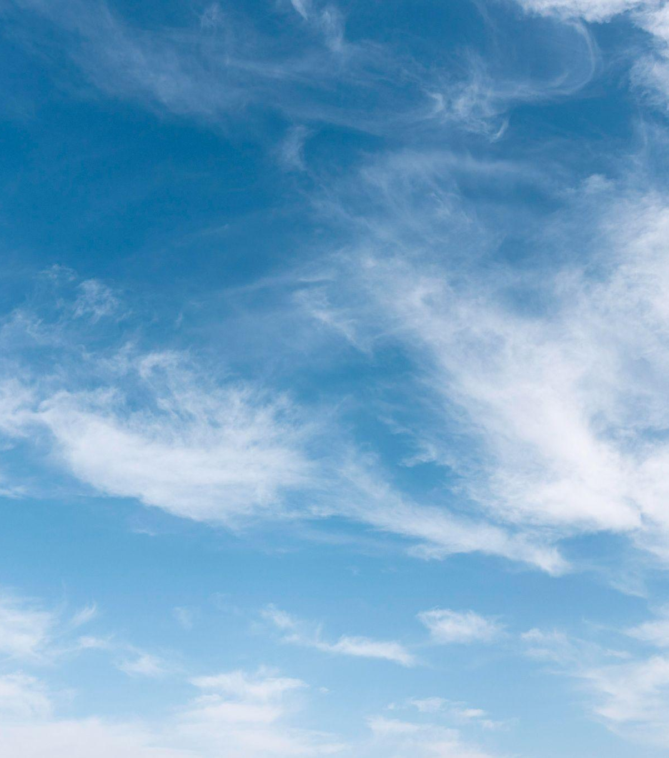
You can write here a long title to captivate the audience attention
Do you know what helps you make your point clear? Lists like this one:
They’re simple
You can organize your ideas clearly
You’ll never forget to buy milk!
You can replace the image. Just right-click on it and select “Replace image”

Slide 5
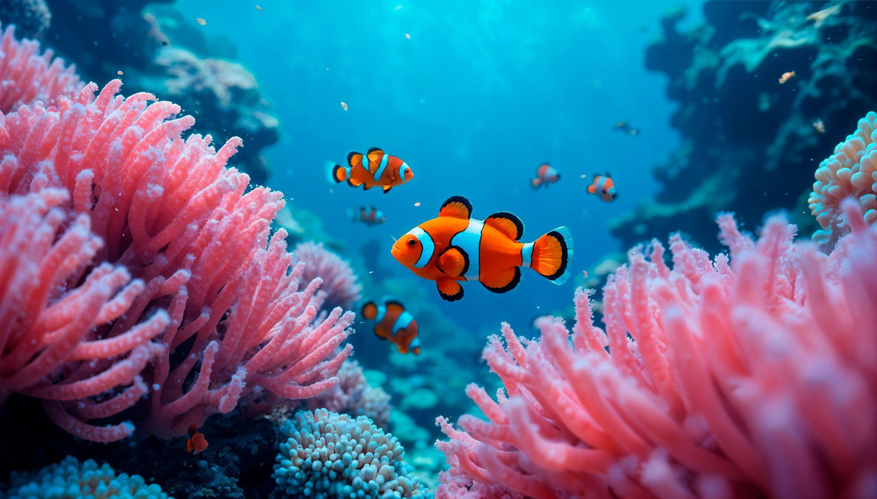
Name of
the section
01
You can enter a subtitle here if you need it

Slide 6
Let’s have a look
Mercury is the closest planet to the Sun and the smallest one in the entire Solar System. This planet’s name has nothing to do with the liquid metal, since Mercury was named after the Roman messenger god. Despite being closer to the Sun than Venus, its temperatures aren't as terribly hot as that planet’s. Its surface is quite similar to that of Earth’s Moon, which means there are a lot of craters and plains. Speaking of craters, many of them were named after artists or authors who made significant contributions to their respective fields. Mercury takes a little more than 58 days to complete its rotation, so try to imagine how long days must be there!

Slide 7
Two ideas
Let’s learn about Mercury
Mercury is the closest planet to the Sun and the smallest one in the Solar System. This planet’s name has nothing to do with the liquid metal
Let’s take a look at Venus
Venus has a beautiful name and is the second planet from the Sun. It’s hot and is the second-brightest natural object in the night sky

Slide 8
Three ideas
01
02
03
Mercury is the closest planet to the Sun and the smallest one in the Solar System. This planet’s name has nothing to do with the liquid metal, since Mercury was named after the Roman messenger god
Venus has a beautiful name, it is very hot and is the second planet in our Solar System. Its atmosphere is extremely poisonous. It’s the second-brightest natural object in the night sky after the Moon
Jupiter is a gas giant and the biggest planet in the Solar System. It’s the fourth-brightest object in the night sky and it has around eighty moons. It was named after the Roman god of the skies

Slide 9
Six different ideas
Mercury
Venus
Mars
Jupiter
Saturn
Neptune
Mercury is the smallest planet in the Solar System
Venus is the second planet from the Sun
Despite being red, Mars is actually a cold place
Jupiter is the biggest planet in the Solar System
Saturn is composed of hydrogen and helium
Neptune is the farthest planet from the Sun

Slide 10
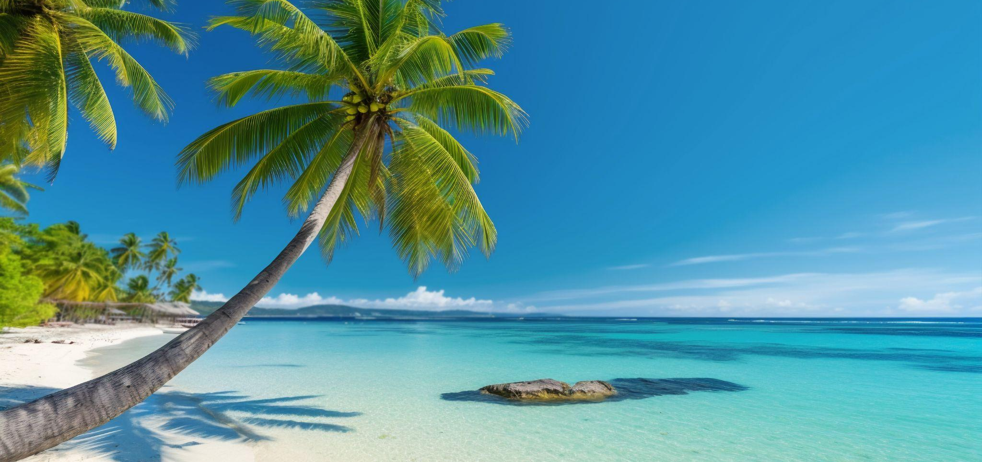
A picture is worth a thousand words
Write your Name

Slide 11
Our history
2XXX
2XXX
2XXX
2XXX
Venus has a beautiful name and it’s the second planet in our Solar System
Saturn is a gas giant, it is the ringed planet and it was named after a Roman God
Neptune is an ice giant and it is the fourth-largest planet in the Solar System
Mars is full of iron oxide dust and despite being red it is a really a cold place

Slide 12
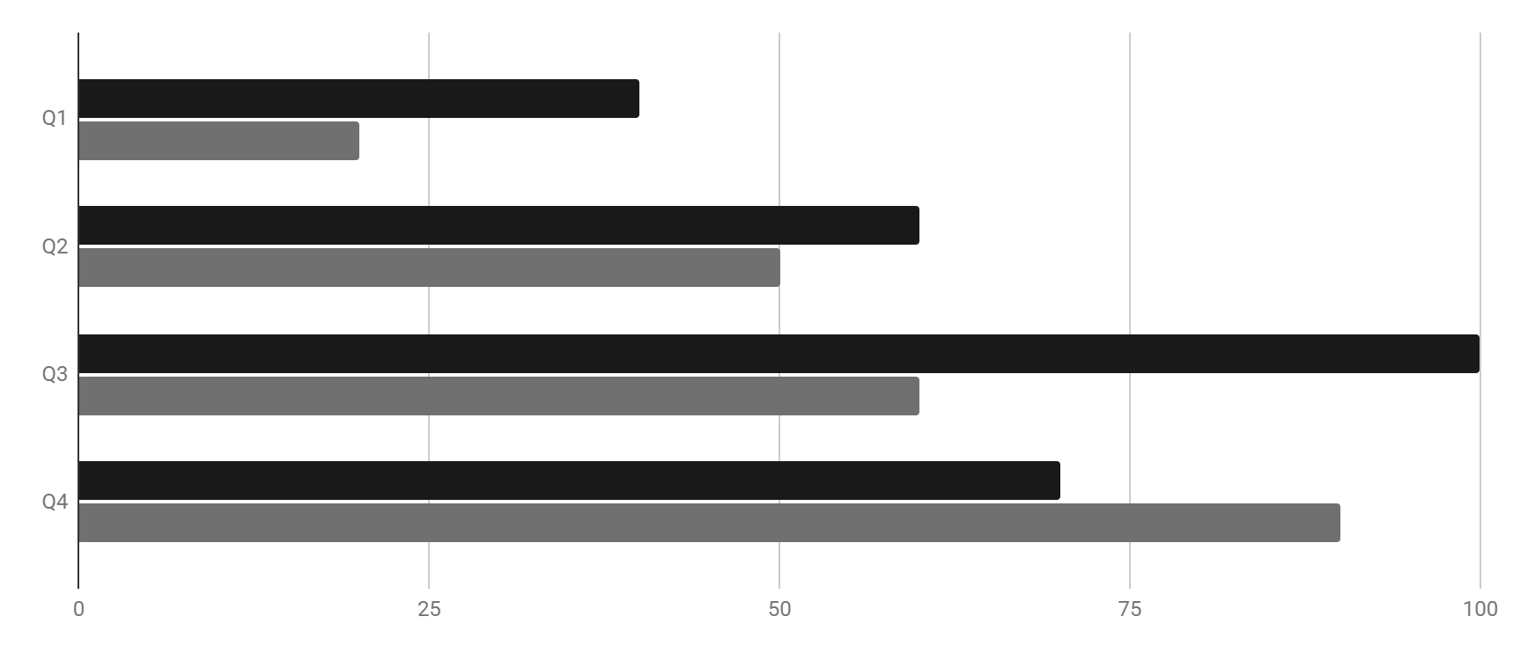
Represent your data here
Year | Venus | Mars
20XX | $0.30 | $31.90
20XX | $3.90 | $15.40
20XX | $157.30 | $492.80
20XX | $3,368.20 | $13,929.80
This is Mars
This is Neptune
Despite being red, Mars is actually a really cold place
Neptune is the farthest planet from the Sun
Follow the link in the graph to modify its data and then paste the new one here. For more info, click here

Slide 13
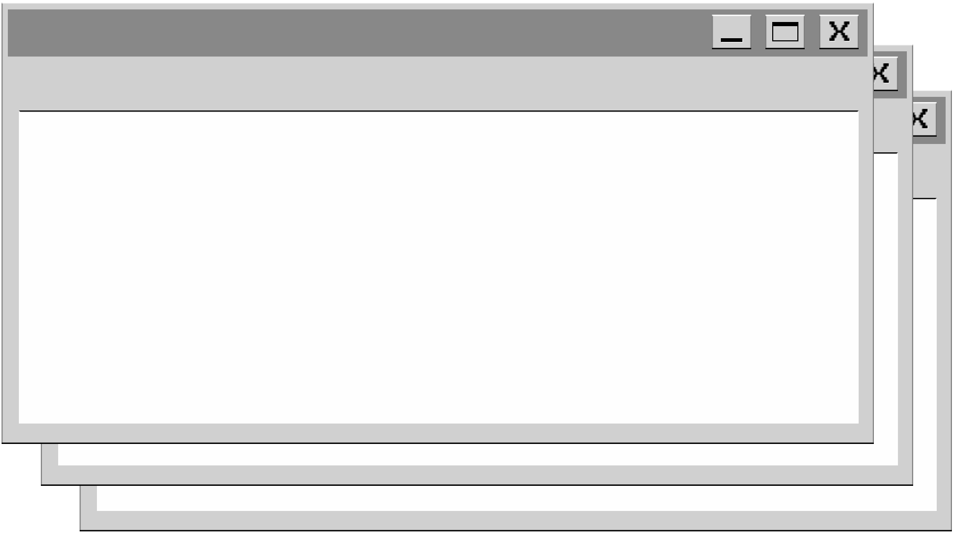
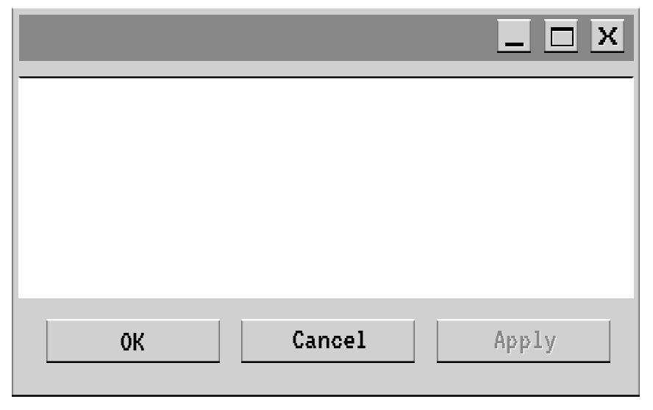
333,000
386,000 km
The Sun’s mass compared to Earth’s
Distance between Earth and the Moon

Slide 14
Thank you
Write your Name
Do you have any questions?
youremail@freepik.com
+00 000 000 000
yourwebsite.com
Please keep this slide for attribution

Slide 15
Instructions for use
If you have a free account, in order to use this template, you must credit Slidesgo by keeping the Thanks slide
As a Free user, you are allowed to:
Modify this template
Use it for both personal and commercial projects
You are not allowed to:
Sublicense, sell or rent any of Slidesgo Content
Distribute Slidesgo Content unless it has been expressly authorized by Slidesgo
Include Slidesgo Content in an online or offline database or file
Offer Slidesgo templates (or modified versions of Slidesgo templates) for download
Acquire the copyright of
Slidesgo Content
For more information about editing slides, please read our FAQs or visit our blog

Slide 16
Instructions for use (premium users)
As a Premium user, you can use this template without attributing Slidesgo or keeping the Thanks slide
You are allowed to:
Modify this template
Use it for both personal and commercial projects
Share this template in an
editable format
Hide or delete the “Thanks” slide and the mention to Slidesgo in the credits
You are not allowed to:
Sublicense, sell or rent any of Slidesgo Content
Distribute Slidesgo Content unless it has been expressly authorized by Slidesgo
Use any of the elements that are part in a separated way
Register any of the elements as a trademark or logo in an intellectual property registry
For more information about editing slides, please read our FAQs or visit our blog

Slide 17
Fonts
Colors
This presentation has been made using the following fonts:
All the colors used in this presentation
Click on the button of the link to the fonts
#191919
#efefef
#707070
VT323
#c1c1bf
#ffffff
Roboto Mono
To view this template correctly in PowerPoint, download and install the fonts we used

Slide 18
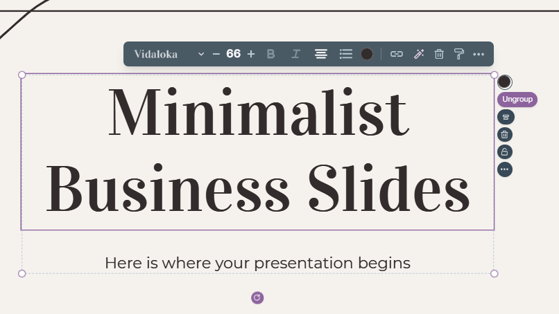
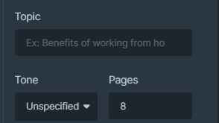
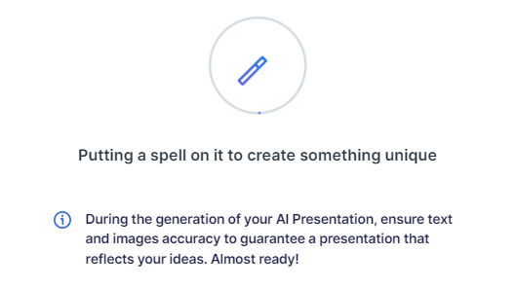
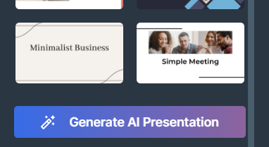
Presentation Maker
Slidesgo introduces its latest feature: the Presentation Maker. Enjoy two main functionalities - firstly, with a few clicks, create marvelous presentations with Artificial Intelligence that adapt to your needs. And it's completely free
Generate AI Presentation

Slide 19
Use our editable graphic resources...
You can easily resize these resources without losing quality. To change the color, just ungroup the resource and click on the object you want to change. You can also look for more infographics on Slidesgo

Slide 22
 | Jan | Feb | Mar | Apr | Jun
Task 1
Task 2
Task 3
 | No | Yes | Yes | No | Yes
 | Yes | No | Yes | No | Yes
 | Yes | Yes | No | Yes | No
 | Jan | Feb | Mar | Apr | Jun
Task 1
Task 2
Task 3

Slide 24
6/10 | 8/10 | 7/10 | 4/10

Slide 25
...and our sets of editable icons
You can resize these icons without losing quality
You can change the stroke and fill color; just select the icon and click on the paint bucket/pen
In Google Slides, you can also use Flaticon’s extension, allowing you to customize and add even more icons

Slide 26
Educational icons
Medical icons

Slide 27
Business icons
Teamwork icons

Slide 28
Help & support icons
Avatar icons

Slide 29
Creative process icons
Performing arts icons

Slide 30
Nature icons

Slide 31
SEO & marketing icons

Slide 32


